Slide 1


Test First - TDD & BDD, What Everyone Should Know
by Shane Hayes,
Octopus Software LLC,
Arlington, TX

Slide 2
Agenda
Importance
Managers
Team members
Approach (15 min)
What is TDD/BDD?
Who does what when?
A coding example (45 min)
Questions/Discussion (30 min)

Slide 3
Importance for Leaders
As a coach and leader, how can you help them if you don’t understand the impact of the:
Approach
Impact on daily work
Especially the implication on the ingrained habits the team members currently have
Collaboration and work allocation
Inputs and outputs
Impact on processes and tooling
Training and support needed
Costs and benefits

Slide 4
Importance to Team Members
How can your team compete in a competitive world economy?
Get on par with “internet native” teams (think Google)
Speed up by:
Improving key collaboration and clarity on real goals
Moving tests earlier in the development lifecycle
Finding testable designs faster and reduce re-design to allow for testing
Preserving business rules in technical and business friendly way
Improve quality by:
Have much faster quality feedback loops
Tighter quality integration with development
We never lose our “why” the work was done (as-built specs)

Slide 5
TDD And BDD, What Are They?
BDD – Behavior Driven Development
Collaborating on business specifications
Using examples to improve communication about story intent,
Preserve that information and make it quickly & sustainably “proveable”
AKA “Acceptance Test Driven Development” or “Specification by Example”
TDD – Test Driven Development
Quick short cycles of design specifications (including detailed examples), creating designs and quickly validating those designs

Slide 6



BDD Flow
Epic 1
Story 1
Story 2
Story 3
Outcome
Story 1
Example 1
Given
When
Then
Customer &
Business
Values
Goal
Theories -Backlog
Lite Design 1
Class 1
Method 1
Method 2
Class 2
Functional/ Spec. Tests
Spec. Edge Tests
Unit/ Design Tests
Deliverables:
Great team collaboration
“Living” spec document
Incremental, provable progress
Balance between spec and unit testing
Discipline on testing and sequence
Applications designed to be auto tested
Not covered: value feedback
Application Code
Red (fail)
Right a test that fails
Refactor
Repeat
Green (pass)
Improve design & code
Just enough code to pass
Notes:
BDD itself does not call out measuring actual value delivered as in a Minimally Viable, Valuable and Validated Product. That can be done by putting in value measurements and usage instrumentation like what is suggested in Lean Startup.

Slide 7
TDD
A simple, very short cycle to:
Write a test for a design
See it fail
Write code (implement design) to get it to pass
Clean and improve design as you go
Red (fail)
Right a test that fails
What impact do you think it has on the code that is written?
Smaller, more focused:
Methods
Classes
Less coupling, fewer dependencies
Repeat
Refactor
Green (pass)
Improve design & code
Just enough code to pass

Slide 8

Who “Does” BDD/TDD?
The “Three Amigos” – PO/BA, Dev and Tester – “everyone”
It starts with the Product Owner who is the subject matter “expert” on what the value is of the Epic/Story
As much as they can, the PO puts pen to paper to describe the value & what they want to get out of the epic/story
Accountable and responsible to the stakeholders to get the value (Key part of job – “cat herder” for stakeholders)
Accountable and responsible to provide clarity to the development team (Key part of job – “speak with one voice” on behalf of stakeholders)
An “Analyst” or other SME can assist the PO in getting clarity on the details – business rule examples
Notes:
Why do I like dev and tester? Two primary reasons:
Having a least two people to perform and important function increases the chance of rule compliance. An example is money handling, almost always done with two people so that they would need to take the risk of collusion to be non-compliant (theft).
Building and testing of have different mindsets, like matching and mis-matching personalities. Both are valuable to the team. Should everyone be able to do both – absolutely, but lets take advantage of people’s strengths and tendancies.

Slide 9
When “Does” BDD/TDD Start?
In Release Planning, the PO will describe the Epics/Story shells to collaborate with team on initial high-level sizing:
Team will take the info from the PO and details just enough to size
Any details and assumptions will be captured:
In order to [get this customer/business value]
As a [role]
I want [this feature or functionality]
And might have acceptance criteria, but usually come later (examples):
Given [a repeatable starting point]
When [system or user action]
Then [a predictable and measurable result]
The PO will add whatever detail they can to maximize the clarity of the story prior to the start of the sprint (continued refinement)
Note - no test automation yet – just collaboration, learning and some “documentation”

Slide 10
Who “Does” BDD/TDD (2)?
In Backlog Refinement:
The PO/BA or other SME will work to define each story to bring in “well baked” stories. Imagine the cost per hour of having the entire squad “write” the story if they don’t
The meeting continues the ongoing collaboration within the team. The focus should be on Acceptance Criteria and design assumptions to make the desired outcome clear (not just the “how”).
The collaboration is additive such as adding UI layouts, UX process designs, other just-in-time research and standards like API
Any new stories added to the backlog during this meeting ideally would have just enough information to size the story

Slide 11
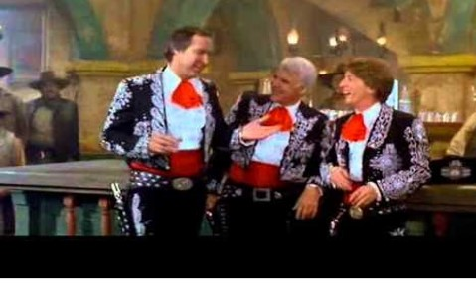
Who “Does” BDD/TDD (3)?
In Sprint Planning, the 3 Amigos will determine:
Decide if we really have a story that is ready according to our Definition of Ready (DOR)
Review details on story, clarify any uncertainty and plan approach to remove uncertainty if some still exists
Decide on approach to specification/unit testing (test plan) in addition to our normal development activities
In Story Execution:
PO/QA/Dev will update the application’s “as-built” specification file- the “.feature” file
Dev/QA will update the step-def file to draft a failing step definition “gluing” the spec to the application
Developer will then start the Red/Green/Refactor process of TDD:
TDD: Write unit test and see it fail
TDD: Write just enough code to get the unit test to pass
BDD: Refactor the step definition to execute application to fail/pass
TDD/BDD: Continue writing tests and code until the step definitions pass
BDD: Start process over on next acceptance criteria
Definition of Done (DOD) will be to measure a complete story
Red (fail)
Right a test that fails
Repeat
Refactor
Green (pass)
Improve design & code
Just enough code to pass

Slide 12
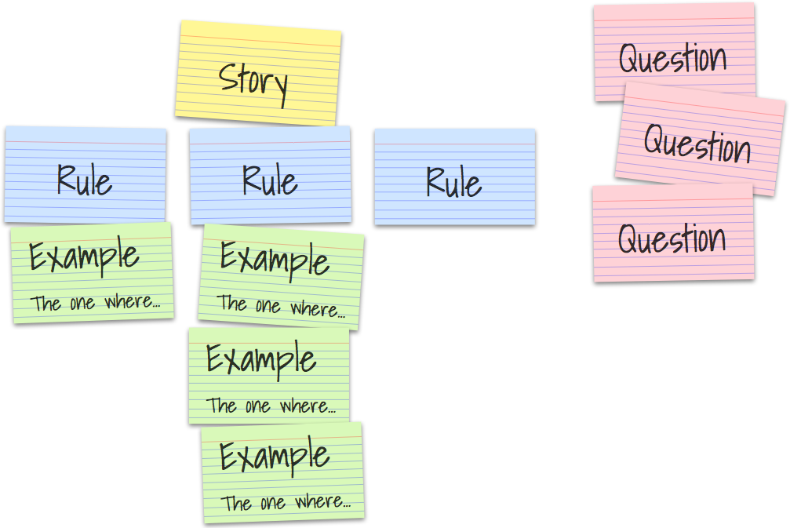
Source of Acceptance Criteria
From Matt Wynne
Notes:
Here is a picture from Matt Wynne’s nice blog on example mapping https://cucumber.io/blog/example-mapping-introduction/

Slide 13

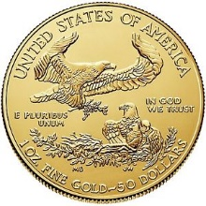
Benefits
Speed up delivery
Increase quality
Improve designs
Deliver accurate, durable “as built” specifications – “stories” do not
Easily pass any traceability requirements
Keep specifications in sync with the reality of the application
Assist with automated testing to keep application durable

Slide 14
Enough Theory – Now an Example
Lets use a Roman Numeral <> Arabic conversion:
Start with an epic & refinement to get good stories
Create a project
Create a feature, scenario, and an acceptance test
Generate a step definition (glue code)
Run the step (functional test) and see it fail
Create a unit test to drive the code development
See the unit test fail
Write application code until the unit test passes
Continue writing application code until feature passes
Continue writing tests then code until all unit and acceptance/specification tests pass
Notes:
As managers, leaders and performers, we all need to understand this in order to make it happen. If the leadership does not understand it well enough, they are likely to miss the value so will discourage their people from learning about it and attempting it.

Slide 15
Feature/ Requirement
Feature: In order to reduce confusion with Roman Numerals
As a reader of roman numerals in a movie studio
I want to translate the numbers to Arabic numbers
Scenario: translate simple numbers
Given a simple Roman Numeral
When I ask for a translation
Then I get the correct Arabic number
Scenario: translate combinations of numbers
Given a Roman Number combination of characters
When I ask for a translation
Then I get the correct translation for combination of Roman numerals in Arabic numbers
What are the details? How do we know if we got this right? Who is an expert on Roman Numbers?
How about an example?

Slide 16
Details on Feature
Scenario: translate simple Roman Numerals to Arabic
Given a single digit Roman Numeral
When I ask for a translation
Then I get the correct Arabic Number:
| Roman Numeral | Arabic Number |
| I | 1 |
| V | 5 |
| X | 10 |
| L | 50 |
| C | 100 |
| D | 500 |
| M | 1,000 |
| B | Invalid Digit |
| # | Invalid Digit |
| 2 | Invalid Digit |
You may know how to translate some Roman Numerals, but imagine how much faster development and estimating will be if you are delivered specification examples? How about geographically separated team mates?
Notes:
A good reason why a description of BDD might be specification by example.

Slide 17
Four Stories in Roman Epic
Why four?
Incremental, real progress
Incremental learning
Smaller stories can be spread across multiple developers
Smaller stories are usually faster – more focus
Story 1
Single digit Roman to Arabic
Story 2
Multiple digit Roman to Arabic
Story 3
Arabic to Roman Conversion
Story 4
Error handling

Slide 18
Open Up Project
We will:
Create a new project with no application code, a maven pom file pointing to the Cucumber and jUnit libraries: RomanConversionStarting
Create a feature file that outlines the business value/intent of what we want to build
Start with an Epic – Support Roman Numeral conversion
Start with one story:
Convert from Roman Numerals to Arabic
Let’s start coding!

Slide 19
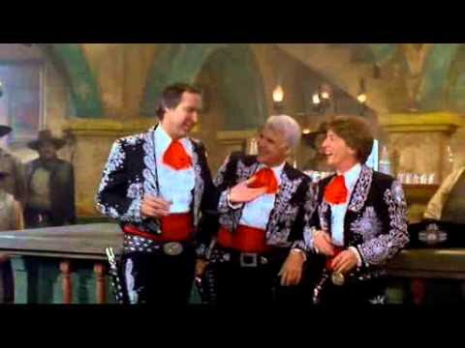
Balance Unit & Functional Testing
Remember, a key part of our approach: collaboration!
The collaboration begins before the sprint, when the team is reviewing & sizing the story
In sprint planning, another round occurs, especially about testing – how far are we going with the various approaches – unit, functional and manual
While we develop the story, we have some collaboration on the testing details

Slide 20



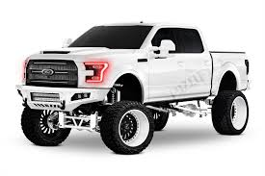

What Do We Mean Validating Design?
Design items like:
Can the vehicle carry freight?
Can it drive on the highway?
Can we monitor tire pressure?
Is the driver protected from the environment?
Does the engine start?
Can the driver turn on lights for driving at night?
Can I lock and unlock the doors remotely?
Is the compression of each cylinder in spec?
Does design satisfy business need like:
Can it haul a 2600 lb Bobcat?
Is it easy to offload and load Bobcat at jobsite?
Notes:
2600 pounds of the Bobcat exceed the capacity of the top two “trucks”

Slide 21
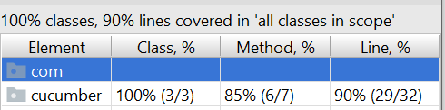
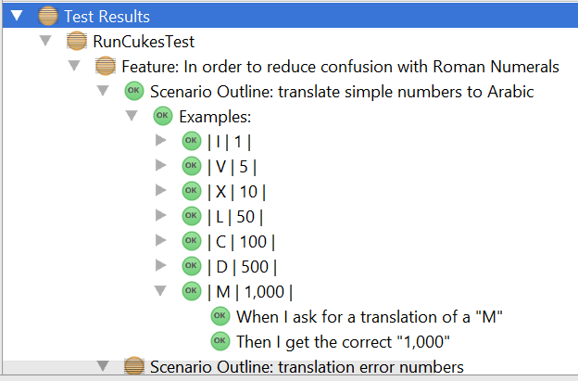
Our Testing Allocation Decision
We will use more of our functional testing than unit testing on the simple conversion
public enum RomanNumeral { M(1000, "M"), CM(900, "CM"), D(500,"D"), CD(400,"CD"), C(100, "C"), XC(90,"XC"), L(50,"L"), XL(40,"XL"), X(10,"X"), IX(9,"IX"), V(5,"V"), IV(4,"IV"), I(1,"I");
public class RomanNumbers { public static int toArabic(String aRomanNumber) throws IllegalArgumentException{ RomanNumeral aRomanNumeral = RomanNumeral.valueOf(aRomanNumber); switch (aRomanNumeral) { case I: return RomanNumeral.I.getArabic(); case V: return RomanNumeral.V.getArabic(); case X: return RomanNumeral.X.getArabic(); case C: return RomanNumeral.C.getArabic(); case D: return RomanNumeral.D.getArabic(); case M: return RomanNumeral.M.getArabic(); case L: return RomanNumeral.L.getArabic(); default: throw new IllegalArgumentException("Invalid Digit " + aRomanNumber);
Notes:
All of our functional tests pass. Are we missing anything? Not much, as the code coverage from our functional testing is at 90%

Slide 22
Three Kinds of Tests
Unit Testing
Functional Specification Testing
Some overlap is OK, we just need to be smart about it
Edge functional testing is important, but does not add to fast understanding of a specification
Examples of edge testing might be errors or boundaries
Edge Functional Testing
Story 1
Single digit Roman to Arabic
Story 2
Multiple digit Roman to Arabic
Living Documentation!

Slide 23
So What Do We Have?
Great and early collaboration on Quality
“Living Documentation” that the business can understand and is “proveable”
Very easy traceability – an “as built” spec
“Stories” do not deliver an as build spec
Imagine your last project was done this way
A fast path to applications that are designed to be testable with automation
Both unit and functional tests with a practical balance between the two
Tests linked, stored and protected with the source code

Slide 24


BDD & TDD in Pipelines
Production
Outcome/
Value
Performance
Functional
Dev
Smoke
Code &
Configuration
Pass?
Tests to Verify
Design (Behavior and Quality)
Fixes
Design
Binary Feedback
Design
Fails
Design
Passes, we can continue

Slide 25
Smoke Test Feedback Loop
Immutable Package
Production
Outcome/
Value
Performance
Functional
Dev
Smoke
Code &
Configuration
Pass?
Test to Verify
Component
Specification
Fixes
Large
Component
Specification
Binary Feedback
Component
Specification
Fails
Component
Specification
Passes, we can continue

Slide 26

Functional Test Feedback Loop
Still Immutable Package!
Production
Outcome/
Value
Performance
Functional
Dev
Smoke
Code &
Configuration
Test to Verify
All Application
Specifications
Pass?
Improvements
Fixes
Full Application
Specification
Binary Feedback
Application
Specification
Fails
Application
Specifications
Passes, we can continue
PO

Slide 27
Performance (and DID) Feedback Loop
Production
Outcome/
Value
Performance
Functional
Dev
Smoke
Code &
Configuration
Test to Verify
Throughput and
Security
Specifications
Pass?
Fixes
Throughput and Security Specs
Binary Feedback
Application
Performance
Specification
Fails
Application
Performance
Specifications
Passes, we can
continue

Slide 28
Production Feedback Loop
Production
Outcome/
Value
Performance
Functional
Dev
Smoke
Code &
Configuration
Measured
Outcome -
Customer &
Business
Value
Meet?
Theory of Customer and Business Value
Learning Feedback
-Learnings to be Applied
-Adjust Theories
-Plan Next Experiment
We Met or
Exceeded
Expected
Value
We Missed
Expected
Value

Slide 29

Questions?

Slide 30
